Slide 1
Artificial Intelligence Methods (AE2AIM)
Lec. 10: Multi-Objective Optimisation
Dr. Xinan (Room PMB 442)
School of Computer Science
The University of Nottingham Ningbo, China
Email: xinan.chen@nottingham.edu.cn
(slides adapted from Prof. Qingfu Zhang’s MOEA/D talk)

Slide 2
In the previous lecture
Hyper-heuristics
Selection based hyper-heuristics
Generation based hyper-heuristics
All methods covered so far are single objective optimisation

Slide 3
In this lecture
Multi-Objective Optimisation
Basic Concepts
NSGAII
MOEA/D

Slide 4
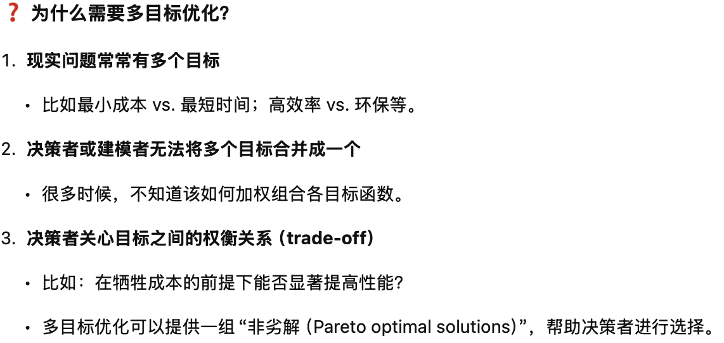
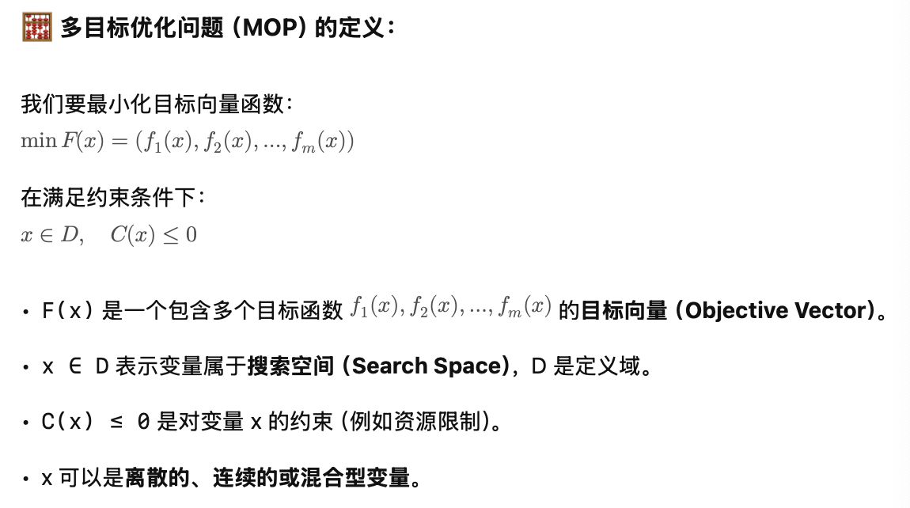
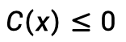
Multiobjective Optimization Problem (MOP)
objective vector
search space
$$C\left(x\right)≤0$$
where $x$ can be discrete, continuous or mixed variable.
Why multiobjective:
By nature, many real-life problems have multiple objectives.
Decision makers (DM) or modellers don’t know how to combine them into one.
DMs want to know trade-off relationship among these objectives.

Slide 5
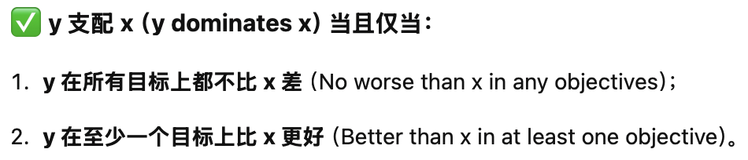
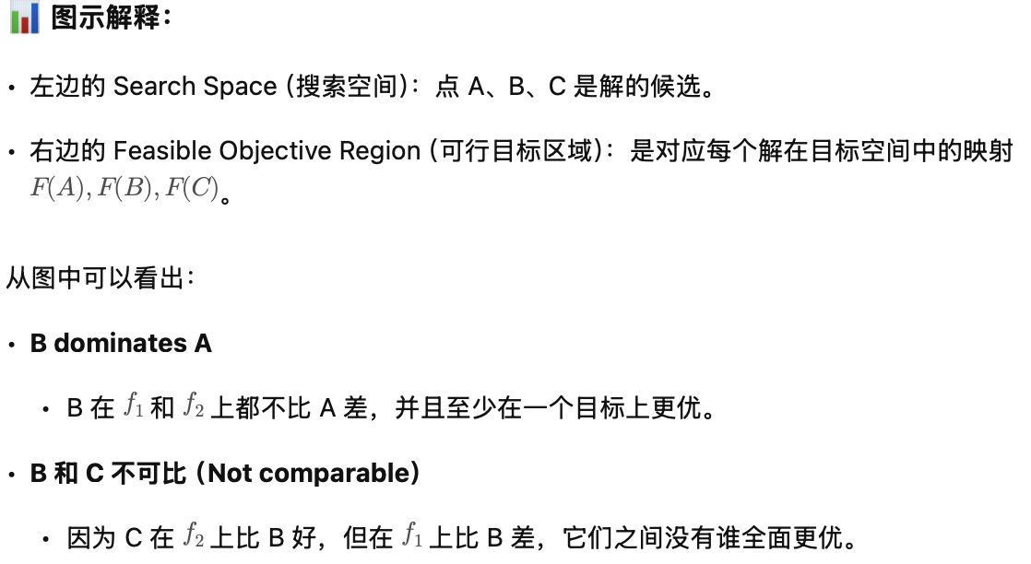
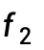
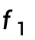
Basic Concepts
Search space
$$f_{2}$$
Feasible objective region
A
F(A)
F(B)
B
F(C)
C
$$f_{1}$$
F
y dominates x if
y is no worse than x in any objs, and
y is better than x in at least one obj.
In this example:
B dominates A.
B and C are not comparable
Notes:
So, people are looking for the best trade-off among different objectives.
Best tradeoff solutions can be defined by Pareto optimality.

Slide 6
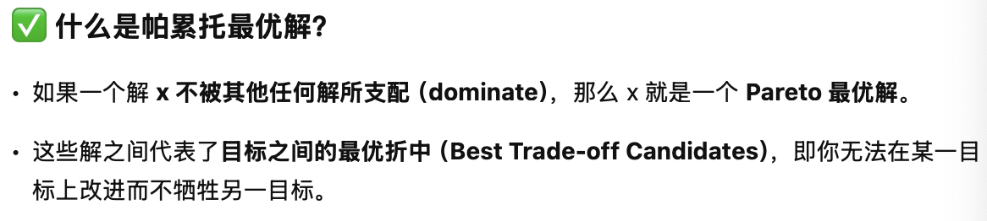
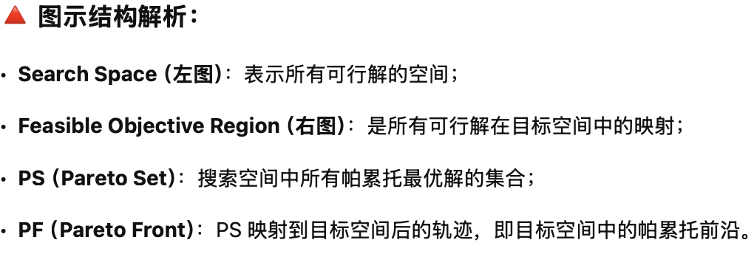
Pareto Optimal Solutions= Best Trade-off Candidates
Search Space
$$f_{2}$$
Feasible objective region
PF
PS
$$f_{1}$$
x is Pareto optimal if no other solution dominates it.
A (rational) decision maker doesn’t like non-Pareto optimal solutions.
Pareto set (PS)= the set of all Pareto optimal solutions in the x-space.
Pareto front (PF) = the image of the PS in the F-space.
Notes:
So, people are looking for the best trade-off among different objectives.
Best tradeoff solutions can be defined by Pareto optimality.

Slide 7
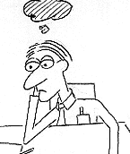



Basic Strategies in MCDM
决策者在优化之前就给出偏好信息，通常是权重。
A-priori
A-posteriori
interactive
The final solution
先生成大量帕累托最优解，再由决策者从中选择。
A number of Pareto optimal solutions
The final solution
算法与决策者反复交互逐步收敛到最终解。
?

Slide 8
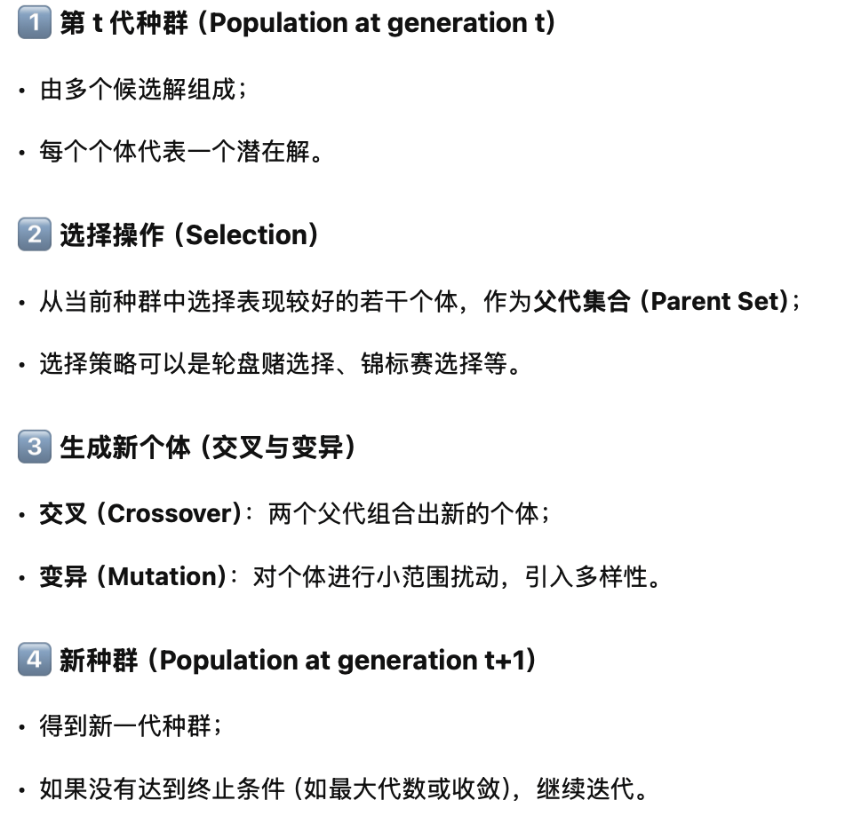
Evolutionary Algorithm (EA) =Population Based Iterative Search Method
A simple EA
Population at generation t
Parent Set
Population at generation t+1
Crossover
Mutation
……
Selection

Slide 9
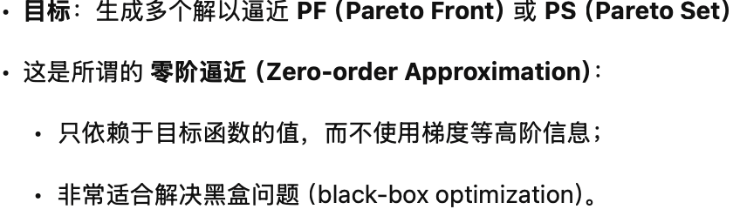
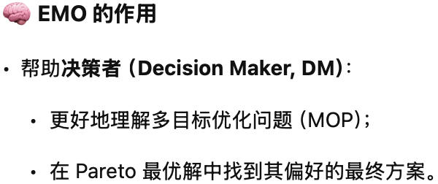
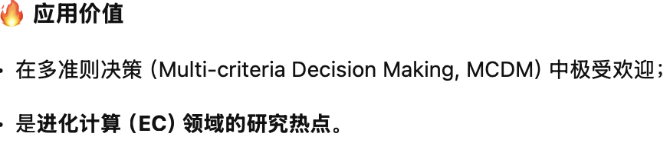
Evolutionary Multiobjective Optimization (EMO)
Generate a number of solutions to approximate the PF (PS) (zero-order approximation).
Help the DM to understand her MOP and find his/her preferred solutions.
Popular and well respected in multicriterion decision making area.
Hottest research area EC.
Notes:
In real-world applications, solving a MOP needs interactions between a decision makers and engineers

Slide 10
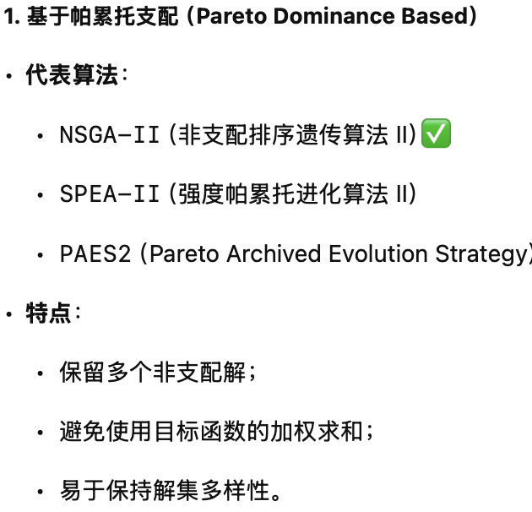
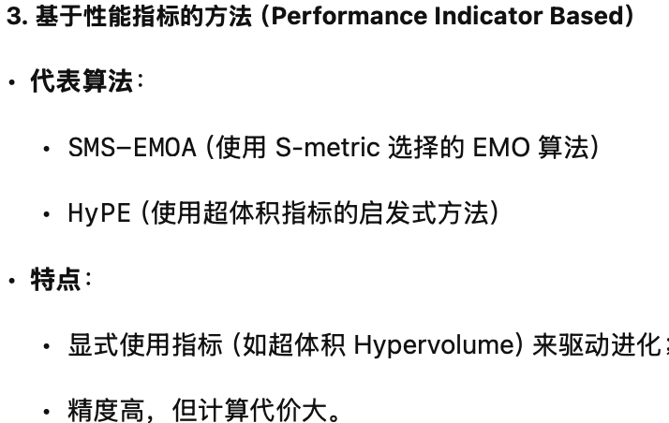
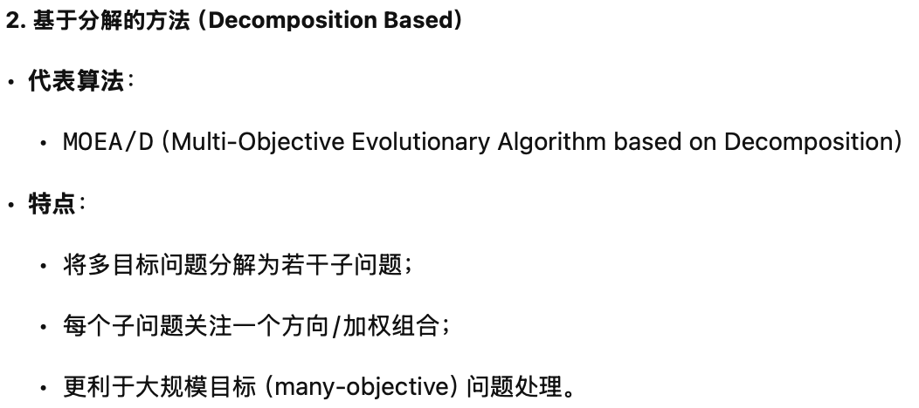
Major EMO Algorithms
Pareto Dominance Based: NSGA-II, SPEA-II, PAES2….
Decomposition Based: MOEA/D
Performance Indicator Based: SMS-EMOA , HyPE….

Slide 11
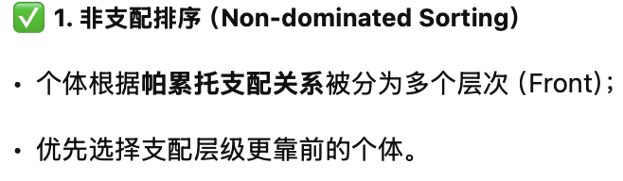
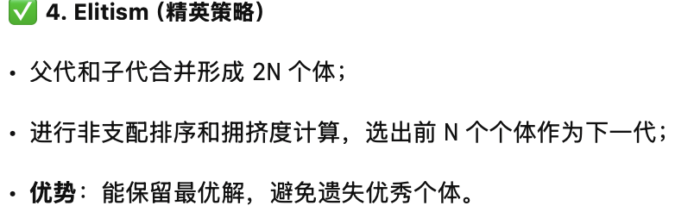
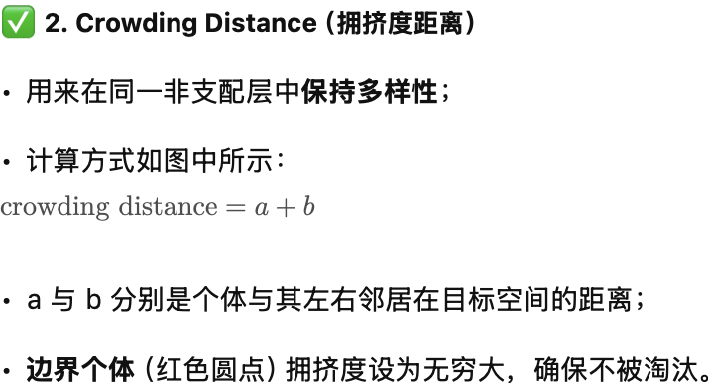
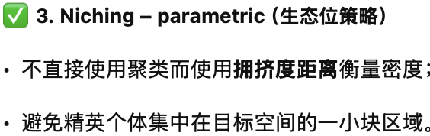
NSGA-II – Non-dominated sorting GA Basic Concepts
这就是 NSGA-II 同时实现 收敛性（convergence） 和 多样性（diversity） 的核心机制。
Niching – parametric
Crowding distance
c=a+b
Ends have infinite crowding distance
Elitism
Keep the best Parent Child individuals from the parent and child population

Slide 12
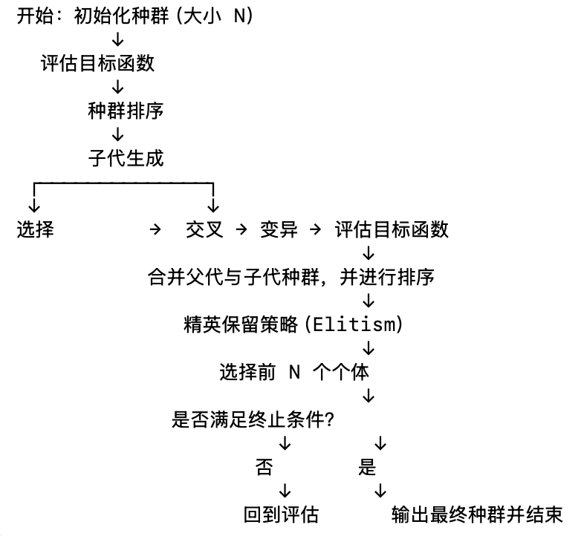
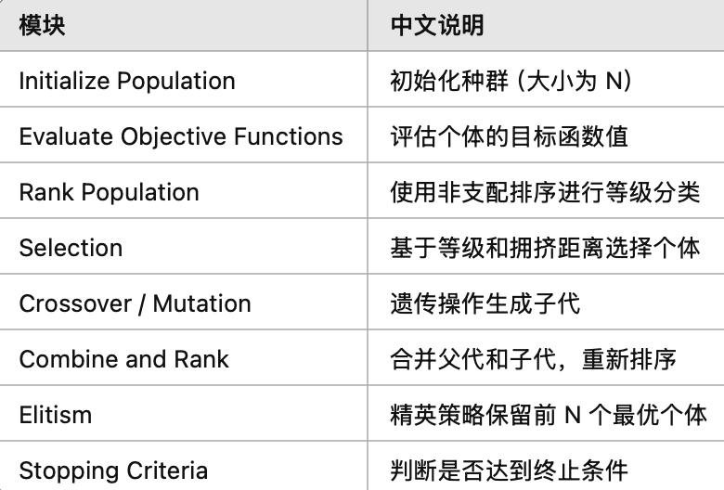
NSGA2-Flow Chart

Slide 13
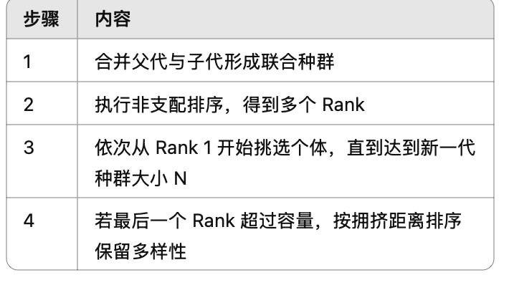
NSGAII – Ranking and Replacement

Slide 14
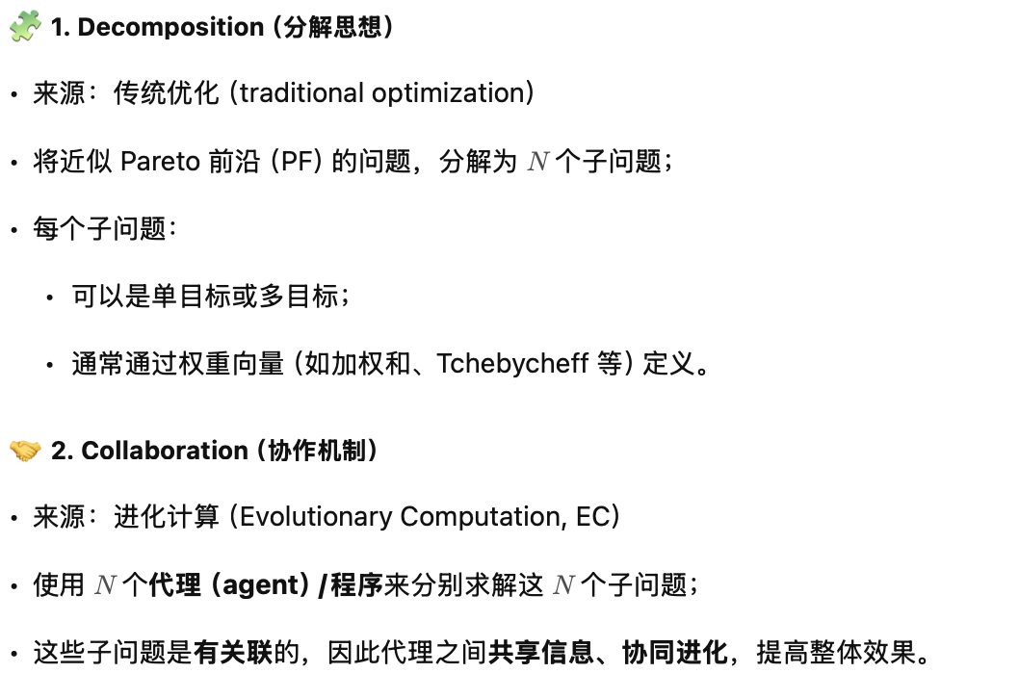
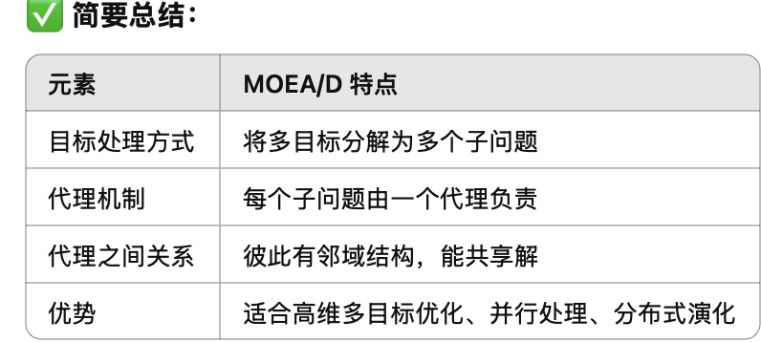
MOEA/D=Decomposition + Collaboration
分解（Decomposition）+ 协作（Collaboration
Decomposition (from traditional opt)
Decompose the task of approximating the PF into N subtasks. Each subproblem can be single objective or multiobjective.
Collaboration (from EC)
N agents (procedures) are used. Each agent is for a different subproblem.
These N subproblems are related to one another. N agents can solve these subproblems in a collaborative manner.

Slide 15
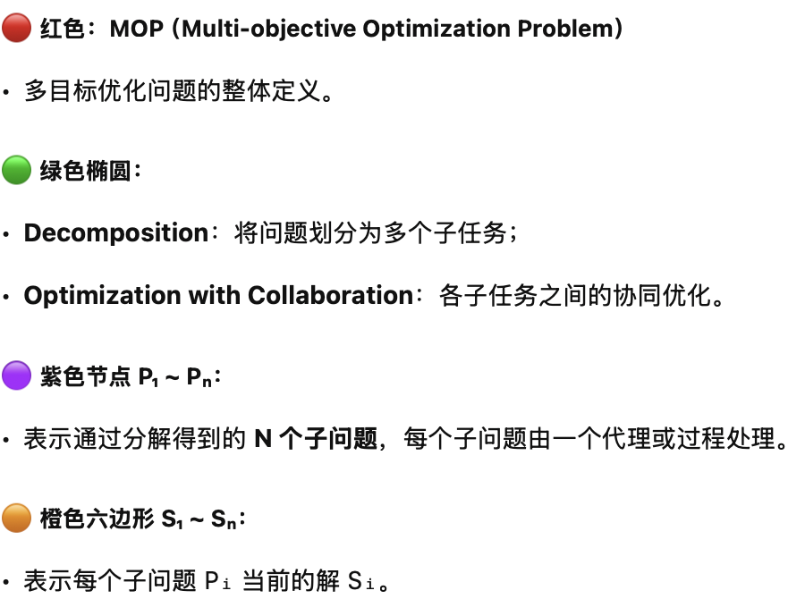
Major Issues
Problem decomposition and neighbourhood structure.
Search method used by each agent: memory and reproduction operators.
Collaboration: mating selection and replacement.

Slide 16
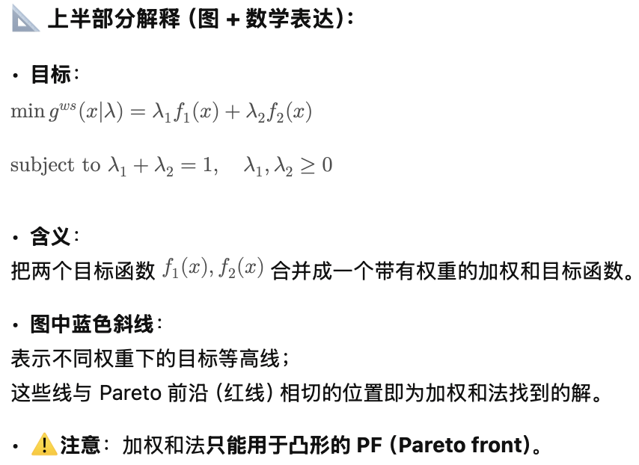
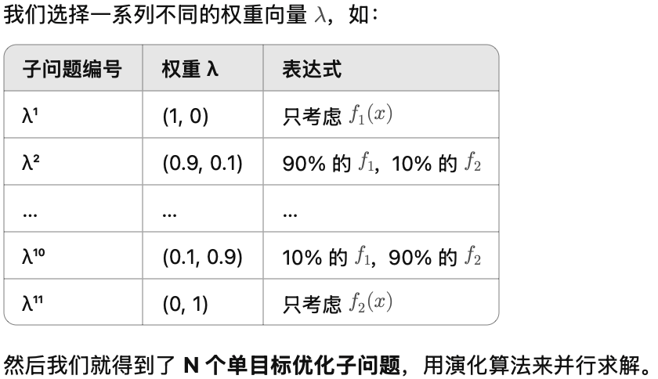
Problem Decomposition
Weighted Sum Approach
It works for convex PF.
Pareto optimal solution
Approximation of the PF
N single obj opt suproblems

Slide 17
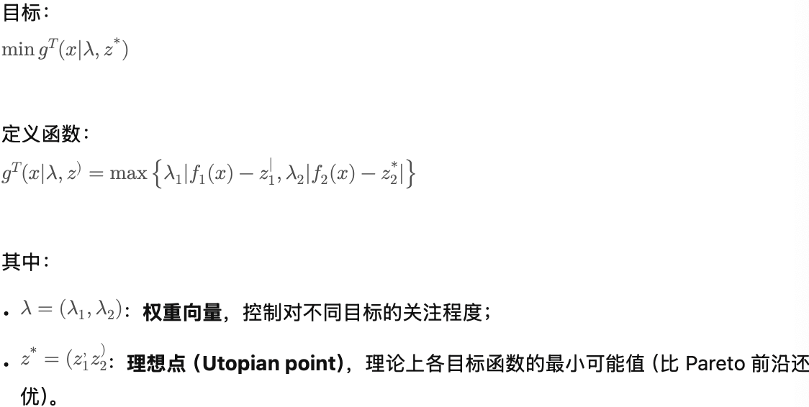
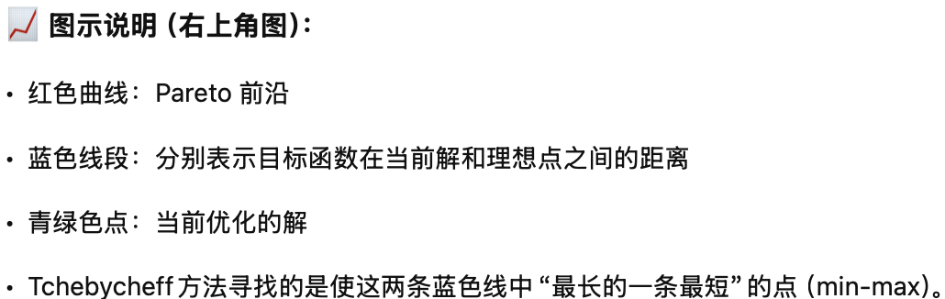
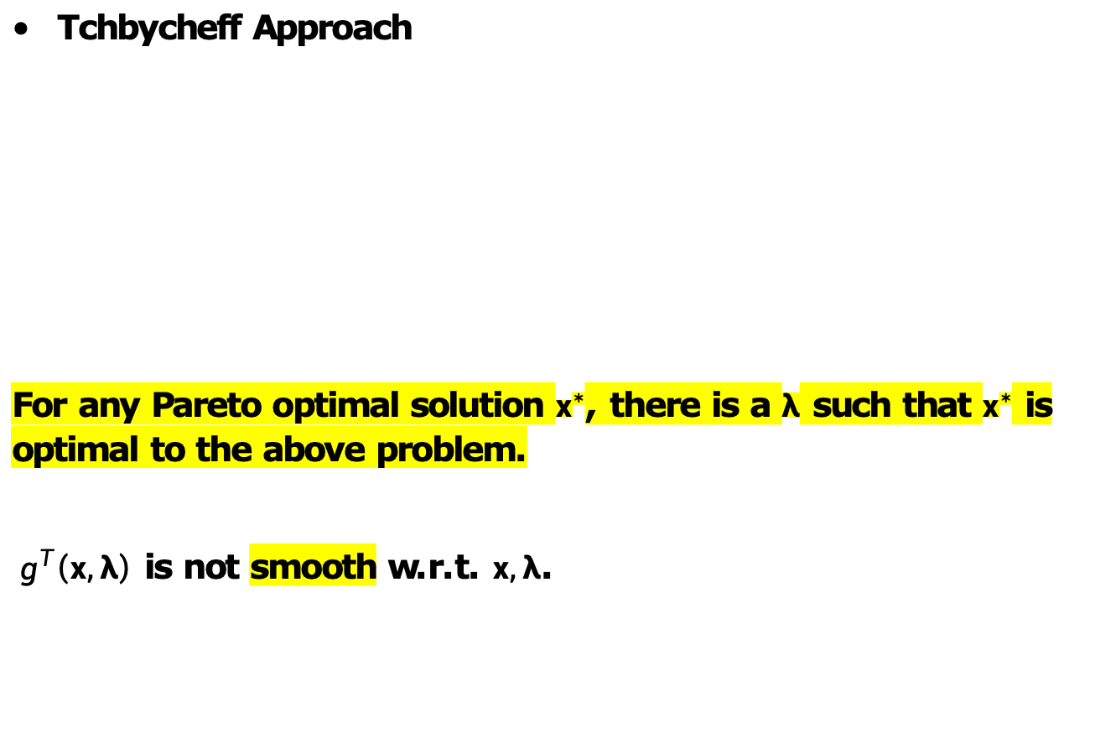
Tchbycheff Approach
For any Pareto optimal solution $x^{∗}$, there is a $λ$ such that $x^{∗}$ is optimal to the above problem.
${ g}^{T}\left(x,λ\right)$ is not smooth w.r.t. $x,λ$.

Slide 18
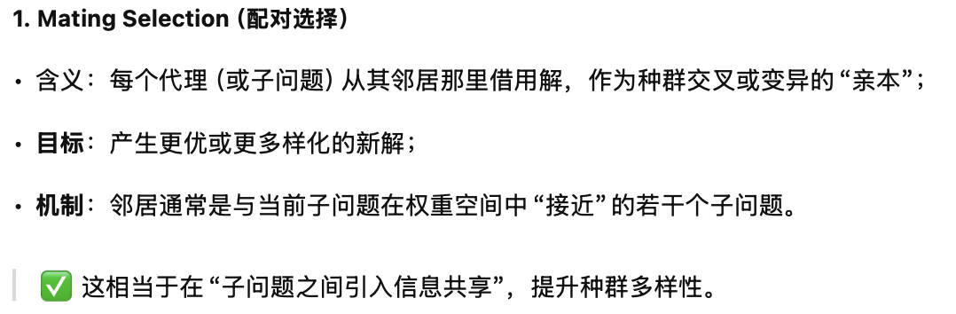
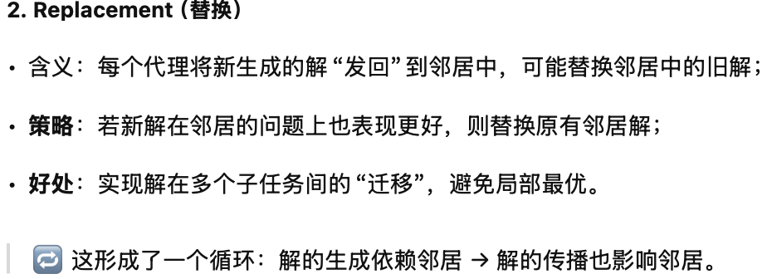
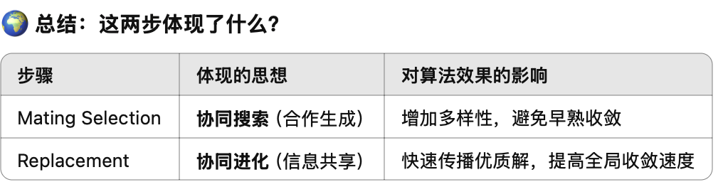
Collaboration among different agents
Mating selection
Each agent borrows solutions from its neighbors for generating new solutions.
Replacement
Each agent sends new solutions to its neighbors.

Slide 19
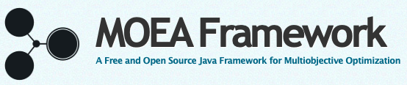
MOP Library
http://moeaframework.org
Java based, free
GUI

Slide 20
Case Study: Bus Scheduling

Slide 21
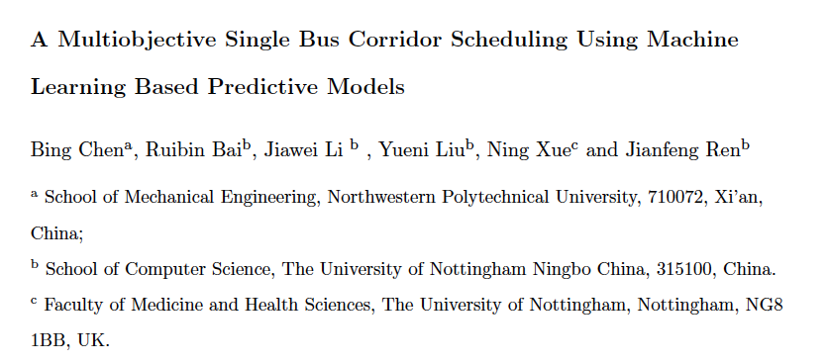
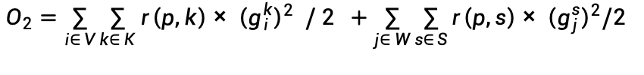
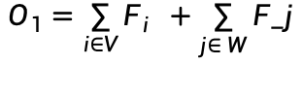
A Bi-Objective Optimisation Model
Objectives
Operation cost
$$O_{1}=\sum_{i∈V}{F_{i}} +\sum_{j∈ W}{F_j}$$
Waiting time
$$O_{2}=\sum_{i∈ V}{\sum_{k∈ K}{r\left(p,k\right)× {\left(g_{i}^{k}\right)}^{2} / 2}} +\sum_{j∈ W}{\sum_{s∈ S}{r\left(p,s\right)× {\left(g_{j}^{s}\right)}^{2}/2}}$$
Overload

Slide 22
The overall framework of the proposed bus dispatching system.

Slide 23
The pareto frontier for a real-life instance

Slide 24
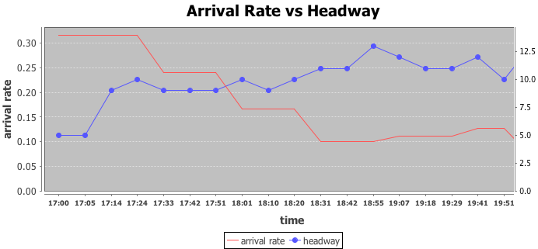
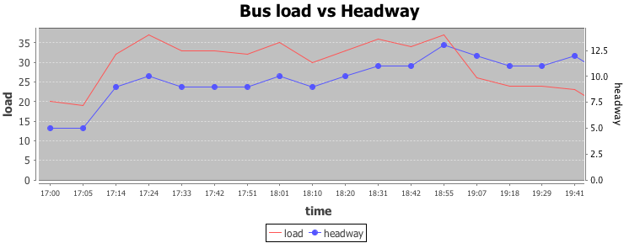
The adaptation to different arrival rates

Slide 25
The next lecture
Review
Any Suggestions?

